Slide 1
Iowa Local Government Risk Pool
Education Energy Group Natural Gas Program
© 2019 Iowa Local Government Risk Pool Commission

Slide 2
What is the local government risk pool?
Term used when governmental entities join together to collectively reduce costs, increase their buying power, or reduce risks. Used in federal & state code language.
The Iowa Local Government Risk Pool Commission (Iowa LGRP) is organized under Iowa Code Chapter 28E, and officially began in the fall of 2019 by three originating K-12 public school districts.
The Iowa LGRP has a Board of Directors responsible for oversight of the programs offered by the 28E.
Schools that wish to join the 28E approve an Application & Agreement to Join the Iowa LGRP to become a member of the 28E entity.
Once a part of the 28E entity, the school district then has the option to participate for a given school year or contract term.
© 2019 Iowa Local Government Risk Pool Commission

Slide 3
What is the Education Energy Group Program?
Districts remit a single lump sum premium payment at the beginning of the fiscal year for each enrolled meter.
This premium covers all gas service requirements for the year (from utility expenses to the gas itself). Participants receive no gas utility bills.
The premium is based on historical usage, calculated at the gas prices the Iowa LGRP procures, plus a risk premium to establish a fixed budget. The wholesale gas cost itself is passed through to the premium with no additional markup. (Discussed more later)
All risks are then transferred to service providers so the district has budget certainty and known heating costs for the fiscal year.
As with other products that transfer risk, there is a tradeoff between cost and certainty. In most years, your district may not save money, but it will protect you from rare events such as super cold winters or the impact of hurricanes reducing production or other items that send costs soaring.
© 2019 Iowa Local Government Risk Pool Commission

Slide 4
What is the Education Energy Group Program?
This is not an insurance program, according to the Iowa Insurance Division and Iowa laws. Rather, this is a local government risk pool through which governmental entities join together to pool and transfer risks.
According to an opinion issued by Iowa’s Auditor of State, the premium may be paid from the district’s Management Fund.
If premiums are paid from the district’s Management Fund, that will also ensure your General Fund will not be impacted regardless of weather events or other gas market supply issues, independent of any long run overall savings.
© 2019 Iowa Local Government Risk Pool Commission

Slide 5
How are premiums determined?
Gas expenditures are calculated by taking usage for each meter multiplied by the price of the gas itself, transportation, tariffs, taxes, and administrative fees.
Anticipated usage for each meter is determined by reviewing historical information and taking into account any known material changes anticipated by the school district (such as a building opening or closing).
The Iowa LGRP service providers lock in gas purchases for pool participants at a fixed price for the gas itself. The service providers assume the risk associated with winter heating needs that exceed historical usage.
The transportation costs, tariffs, taxes and administrative fees from the utilities are generally known, however they can change. The risk of any changes would be borne by the service providers.
The Iowa LGRP limits underwriting profits of its service providers. In the event that profits exceed the profit threshold, Iowa LGRP is empowered to distribute refunds of excess premium back to participants.
© 2019 Iowa Local Government Risk Pool Commission

Slide 6
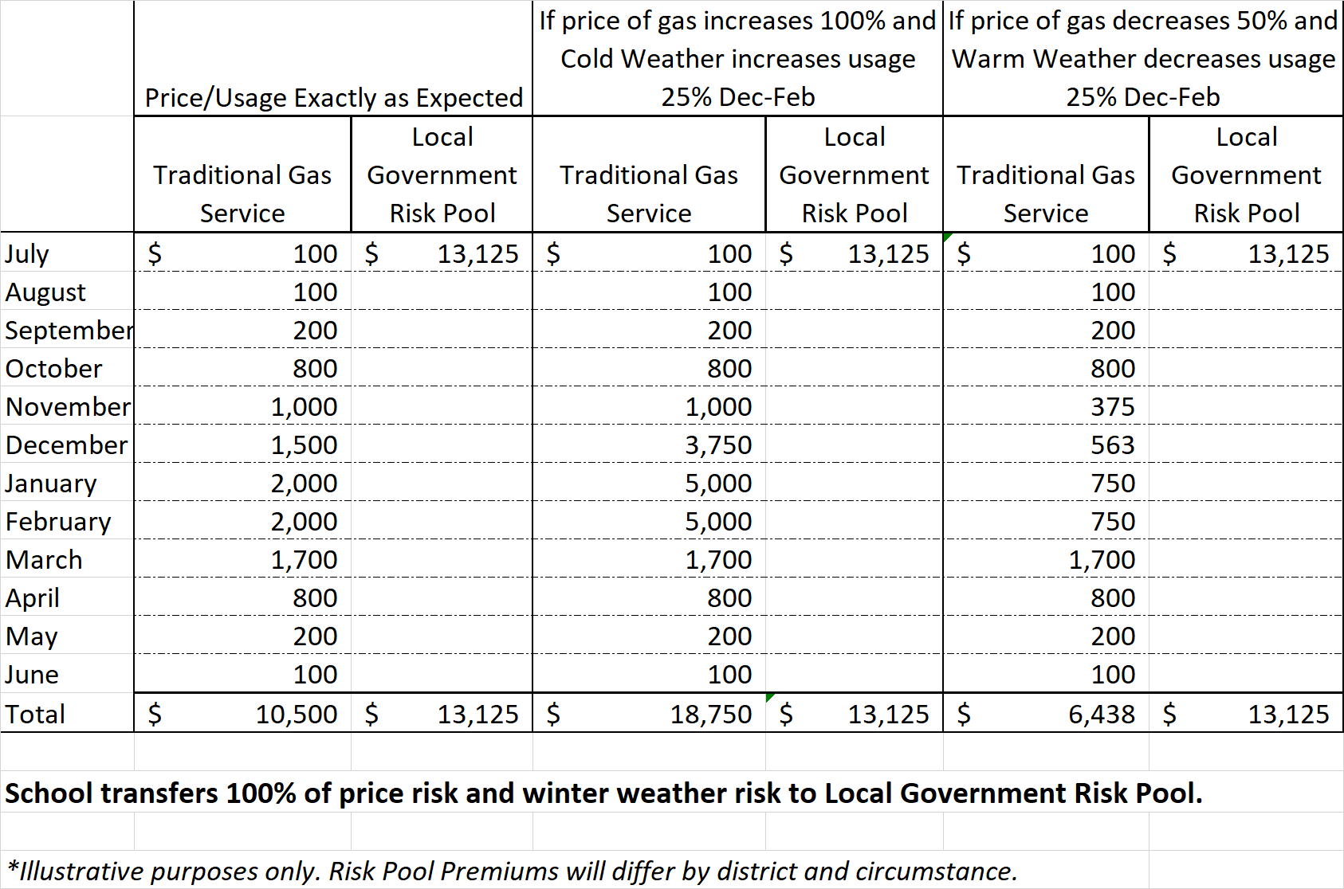
What happens if prices go up or down?
If pricing & usage are exactly as anticipated, the school pays slightly more.
If pricing & usage increase, school pays significantly less.
If pricing & usage decrease, school pays significantly more.
But in all scenarios, school has budget certainty knowing their annual premium, and has protected their General Fund.
© 2019 Iowa Local Government Risk Pool Commission

Slide 7
What happens if a rate event occurs, can my district be assessed for additional premium?
The total premium in the Participation Agreement is the entire amount a school district will owe for participating meters during the term of the Agreement, unless the district experiences a “material event”.
The definition of a material event is defined in the Participation Agreement but includes adding or removing a building, changing equipment, etc. It is important to notify the service providers right away if you experience or anticipate experiencing a material event. Material events may result in an additional premium owed or a refund of premium.
Outside of material events, there will be no additional charges or assessments to the district. Risks are borne by the service providers.
The Participation Agreement commits a district for participation only for the term defined in the Agreement. The district can choose whether or not they wish to participate in subsequent fiscal years with new Participation Agreements.
© 2019 Iowa Local Government Risk Pool Commission

Slide 8
Next Steps?
Quote/Participation Agreement based on historical information
Join the Iowa LGRP 28E entity
Participate in the Education Energy Program
Other steps/paperwork/questions
Questions:
Jen Albers, jen@iowaschoolfinance.com, (515) 251-5970 x4
Jon Muller, jon@iowaschoolfinance.com, (515) 251-5970 x7
Larry Sigel, larry@iowaschoolfinance.com, (515) 251-5970 x3
Don Krattenmaker, don.krattenmaker@woodriverenergy.com, (888) 510-9315
© 2019 Iowa Local Government Risk Pool Commission

